Slide 1
XAMP
XAMPP is a completely free, easy to install Apache distribution containing MariaDB, PHP, and Perl.
PHP development environment
Create a local Apache server
To run PHP scripts, you need Apache
Watch the installation video on the link listed below before you install
Link
I will not recommend to install it in USB. It can be a pain when you take in and out USB. Install it in C drive. No need to change ports

Slide 2
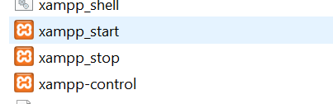
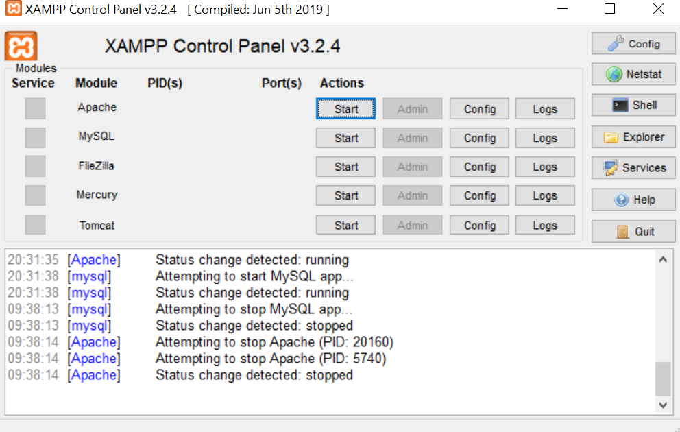
XAMP – Control Panel and run your first script
After installing XAMP, locate your XAMP folder, it will be in C drive, if you have
installed it there.
2) Open the control panel, by clicking on the xamp-control
3) Start the Apache
4) Start MySQL
5) Open Chrome and type Localhost, you will see
default website
6) This website is in htdocs folder which is in XAMP.
7) Delete default website
8) Check localhost again,
no website will be displayed
9) Create a folder, and save all
your scripts inside this folder
10) Any work in htdocs can be
viewed in browser

Slide 3
How to run PHP script
Write a PHP script using Notepad++ (or anyother IDE). See an example on next slide.
Save it with an extension .php, check in the save as, scroll it down to until you see the php. File needs to have .php extension. This file needs to be in the folder that you created in htdocs on the last slide.
To view file in browser, type localhost/foldername/filename
// foldername is the same foldername that you created in htdocs
//filename, is the name of your php file
Control panel can get broken easily. For starting CP, always start Apache first and then other services. For stopping, other services should be stopped first and Apache at the end. If you are not using CP, it should not be running.

Slide 4
Example of PHP script
<?php echo "<h2>PHP is Fun!</h2>"; echo "Hello world!<br>"; echo "I'm about to learn PHP!<br>"; echo "This ", "string ", "was ", "made ", "with multiple parameters."; ?>

